Slide 1
Content moderation for chat systems and social media
Presented by:
Preeti Ranjan Panda
Koyya Khushhal Reddy
Satyanand Prasad
Naman Sharma
Aryamaan Srivastava

Slide 2
BUSINESS NEED

Slide 3
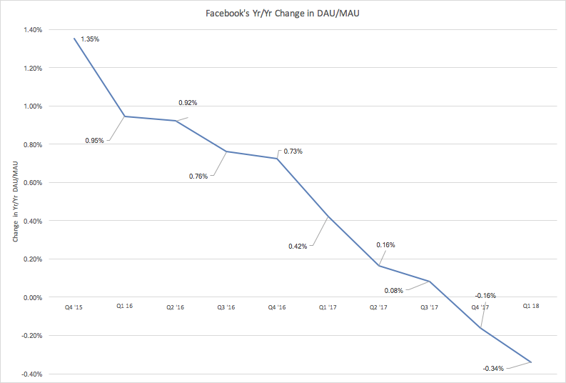
BUSINESS PROBLEM
BUSINESS PROBLEM
In today's world, it is a well known fact the internet and social media can be used to influence opinions and spread hate. Although the platform is not to blame, popular brands like facebook lose customers and their usage statistics go down because many people find some content offensive or inappropriate.
UNMET NEED
The graph on the right shows the decline in facebook’s usage over the years. One of the main causes for the decline is that people don’t like what they see on facebook anymore.

Slide 4
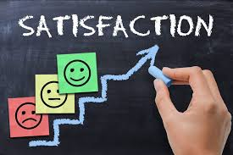
IMPORTANCE OF THE PROJECT
Apart from this, online meetings and classes are also affected by spamming and vulgar content. This affects companies like Zoom, Microsoft Teams, etc. as they lose customers. All companies know how important customer satisfaction is to their profit and content moderation can play an essential role in providing a platform where there is no space for Racism, Hate Speech, Vulgarity or any offensive content whatsoever.
Thus the project has a strong financial and social/ethical base.

Slide 5
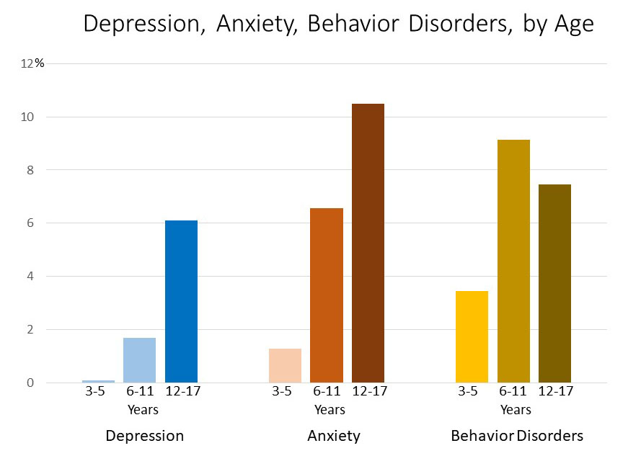
VALUE CREATED BY THE PROJECT
The project aims to create an environment where some malicious users cannot affect the experience of lives of other users. It discourages and aims to eliminate any forms of cyber bullying, racism/discrimination, hate speech,etc.
Cases of depression, anxiety and behaviour disorders are increasing and this is seen to be directly linked to the outburst of social media and the internet phenomenon. Many documentaries like the “The Social Dilemma” are also trying to address these issues.Since these things have become such an important part of our lives, eliminating them is not viable, so we aim to improve the platforms.

Slide 6
TARGET SEGMENT

Slide 7
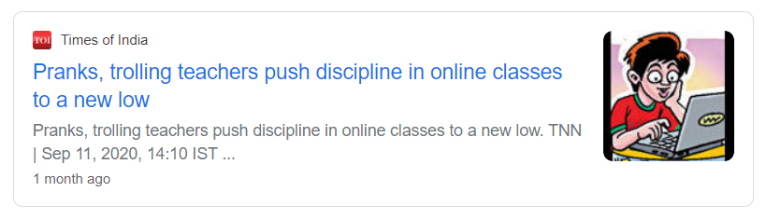
ONLINE EDUCATION /
E-LEARNING

Slide 8

• With the current pandemic situation and with the uncertainty of vaccine, e-learning is the future of the education system.
• However, the limits of these platforms are not restricted as in case of a regular classrooms, where the teacher is the only source of information and moderates the environment.
• E-learning empowers the students to express themselves. With this, the environment of the class is prone to get filled with negative and unacceptable content and hinder the decorum of the class.

Slide 9
These comments may be targeted towards the teacher in-charge or any particular student.
Also, unnecessary topics and debates may shoot out in the class chat which may disturb the momentum of the class. Unnecessary stuffs involves discussion of any other topic except the subject, for ex- sports(IPL), movies, etc.
To avoid these comments to float on the class chat, teachers often disable the comment section for the students. As a result, legitimate and valid doubts of the students are not addressed.

Slide 10
Our model when implemented on these teaching platforms will eliminate the comments, personally targeted on either the teacher or a student.
It will have a check on the messages sent by the student, before being publicly displayed in the chat.
These steps will ensure a positive environment in the class and will maintain it’s decorum.

Slide 11
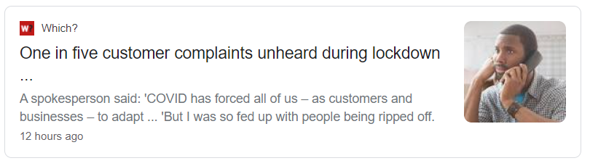
CUSTOMER SUPPORT /
CUSTOMER SERVICE

Slide 12

Customer support has been the only link between the struggling customers who face difficulty while understanding the features of the application or face an issue while using their services.
There has been a sudden boost in various online service for instance- Grofers, UrbanClap, PayTM, etc.
With the increase in the number of customers, the work of the customer staff has increased exponentially.

Slide 13
Not all the customers are being addressed by the support staff and even if addressed, the help the support staff offer are often misused by the customers.
Either redundant complaints are raised by the customers or the employees have to face cyber bullying from the customers.
Our model, when integrated with these platforms, will filter duplicate or harsh queries before it reaches our support staff. They will be only shown genuine complaints, and are required to address those only.

Slide 14
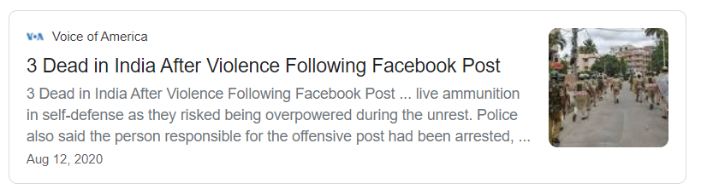
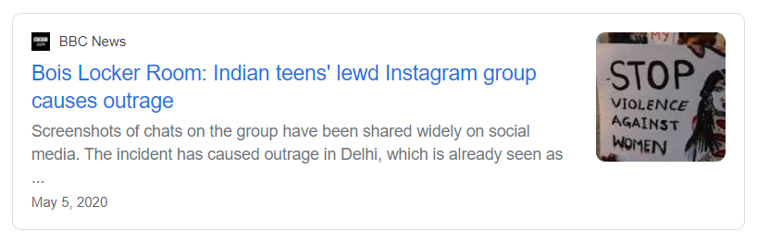
SOCIAL MEDIA

Slide 15

Social media has proved to be really handy, when we acknowledge the fact that it has actually connected people over thousands of kilometers in this lockdown.
However, the repercussions of these platforms are seen to cause more unrest in the society.
In the recent past, people have been very vocal about their opinions, and have been posting offendable posts. This has caused social unrest and even riots between various sections of the society.

Slide 16
Also various famous personalities have been the victim of cyber-bullying and their inbox gets flooded with various spams and redundant messages.
The proposed model will filter the user’s post before publishing on the platform. Each form of data either be video, image or text post will be passed through the model.

Slide 17
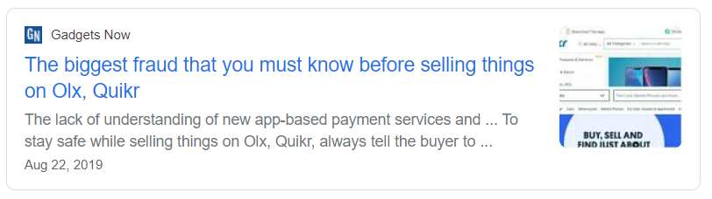
SECOND HAND MARKET

Slide 18

Companies like OLX, that allow people to sell property that they don’t need anymore, are not very popular anymore. The second hand product market is still large and many people are still in need of useable products at a cheaper price.
Some major reasons for the decline of such services are that people don’t trust the sources anymore, and that people don’t find appropriate deals.

Slide 19
To tackle these issues, our algorithm will filter out the appropriate buyers and sellers by analysing the conversation between them.
It will try to recognize if any of the users are attempting anything malicious by checking expected price with offered prices.
Any large mismatch will be reported and the algorithm will continuously take feedback from the users to be better prepared for future scenarios.

Slide 20

MARKET SIZE AND GROWTH
After the coronavirus pandemic is behind us, education and most office workers will shift back to offline classrooms and workspaces.Businesses like Zoom would not earn as much as they have earned in the pandemic.
But if we are able to get people to trust online platforms, that they can also be a means to provide quality education without much disturbance and with great convenience, then the online education market will undergo a massive growth.

Slide 21
Many businesses have started admitting that they now realise that a lot of the work done by employees can be done by them from their homes, and if the online platforms are able to moderate meetings and conversations to keep them precise and clean to avoid distractions and keep them professional, then Work From Home can become a regularity.
Same can be applied to businesses like second hand businesses for example, where if the trust between the buyer and seller is established, then many small businesses can shift online as well and start increasing their profit.

Slide 22
SOLUTION IDEA

Slide 23
LINK TO DEMO VIDEO
https://drive.google.com/file/d/1XEUu5F2_KTktem6P8gJdNDAMI_rP-eov/view?usp=sharing

Slide 24
Idea
Our idea is to develop a filter which can be embedded in any chat system or social media to prevent cyberbullying, hate spread, obscenity etc.
Using a 1-D convolution neural Network/Pre-trained models like GPT2 to classify text as hate speech, racist, vulgar, or spam, etc. to prevent
Using LSTM/GRU to analyse a series of messages/text to understand the emotion behind them and then taking necessary actions.
Using 2-D CNNs to classify inappropriate images.
Using OCR Engines to Extract text from a image and preventing its channeling if found inappropriate.
CNNs Combined with RNNs to extract and analysis the Video streams.

Slide 25
USE CASE DIAGRAMS

Slide 26
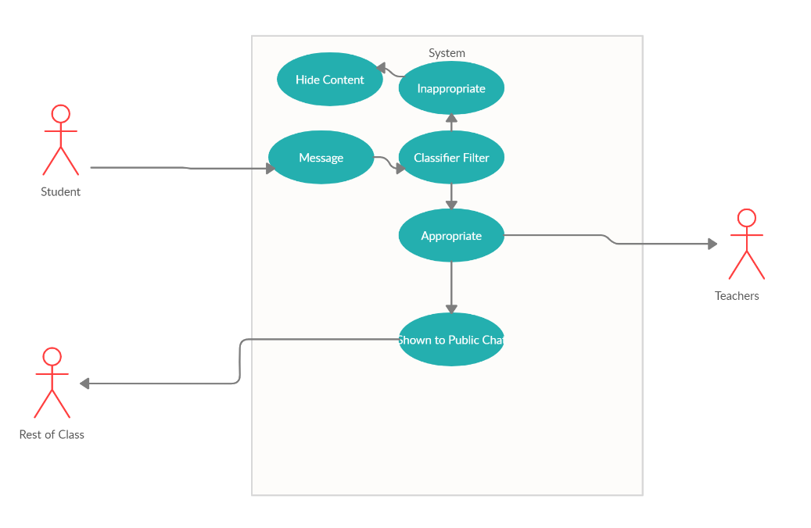
ONLINE EDUCATION:

Slide 27
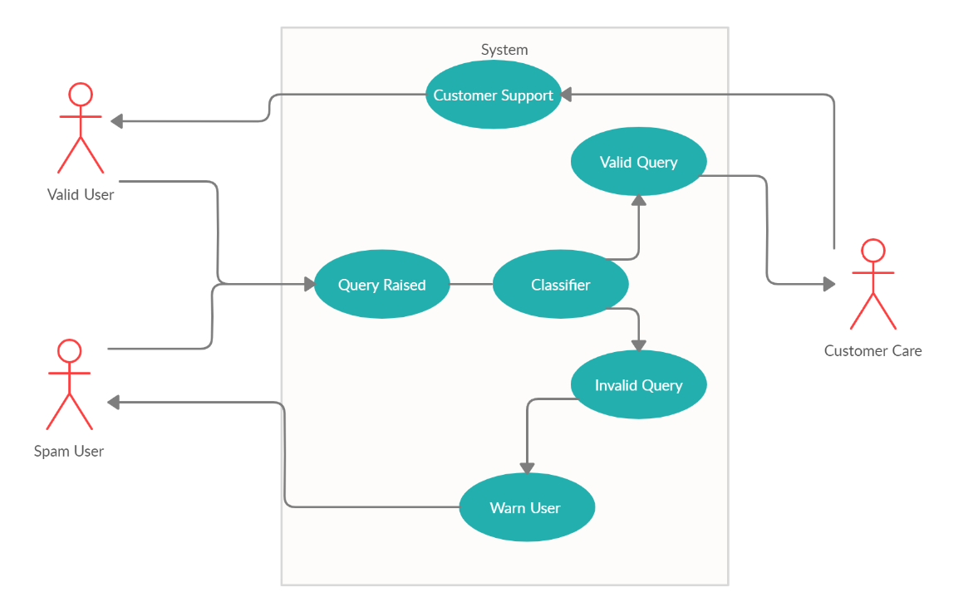
CUSTOMER SUPPORT:

Slide 28
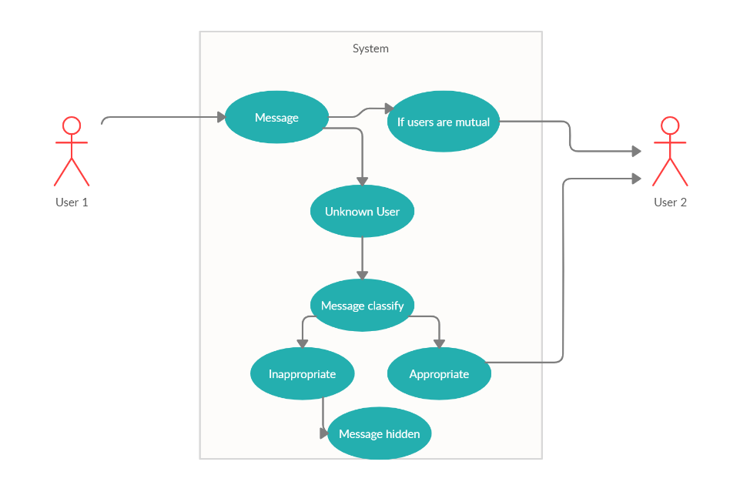
SOCIAL MEDIA:

Slide 29
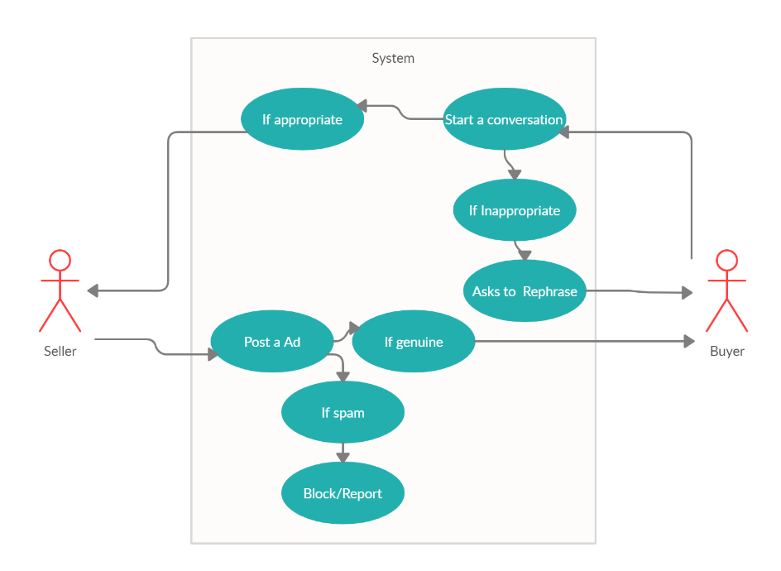
SECOND HAND ONLINE BUSINESS:

Slide 30
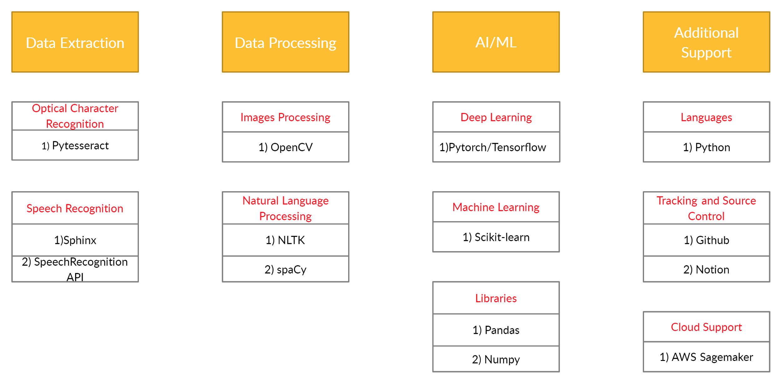
Technology Stack

Slide 31




Overview of Our Tech Stack
Languages : Python. We will use Python basically for everything, from Modeling to ETL.
AI/ML : Pytorch/Tensorflow(for most Deep Learning Tasks) and Scikit-Learn(Our go-to for most Non DL Tasks).
NLP : NLTK/spaCy for extracting features from the text data.
OCR : For extracting Text from images, we’ll rely on Tesseract OCR Engine.
Speech Recognition : Analysing Audio input can be achieved through Speech to text Conversion. We’ll use Sphinx for the same.
Version Control : Github is the best choice for any group project for code control and tracking.

Slide 32
7) Additional Libraries: Pandas, Numpy, MatplotLib.
8) Google Colab for GPU support.
9) Project Management: We use Notion and We find ourself using Notion for more than just project management and tracking. We will be able to keep track of what Our Team Members do on a daily basis, make sure that we allocate time efficiently, and track what everyone on the team is up to.

Slide 33
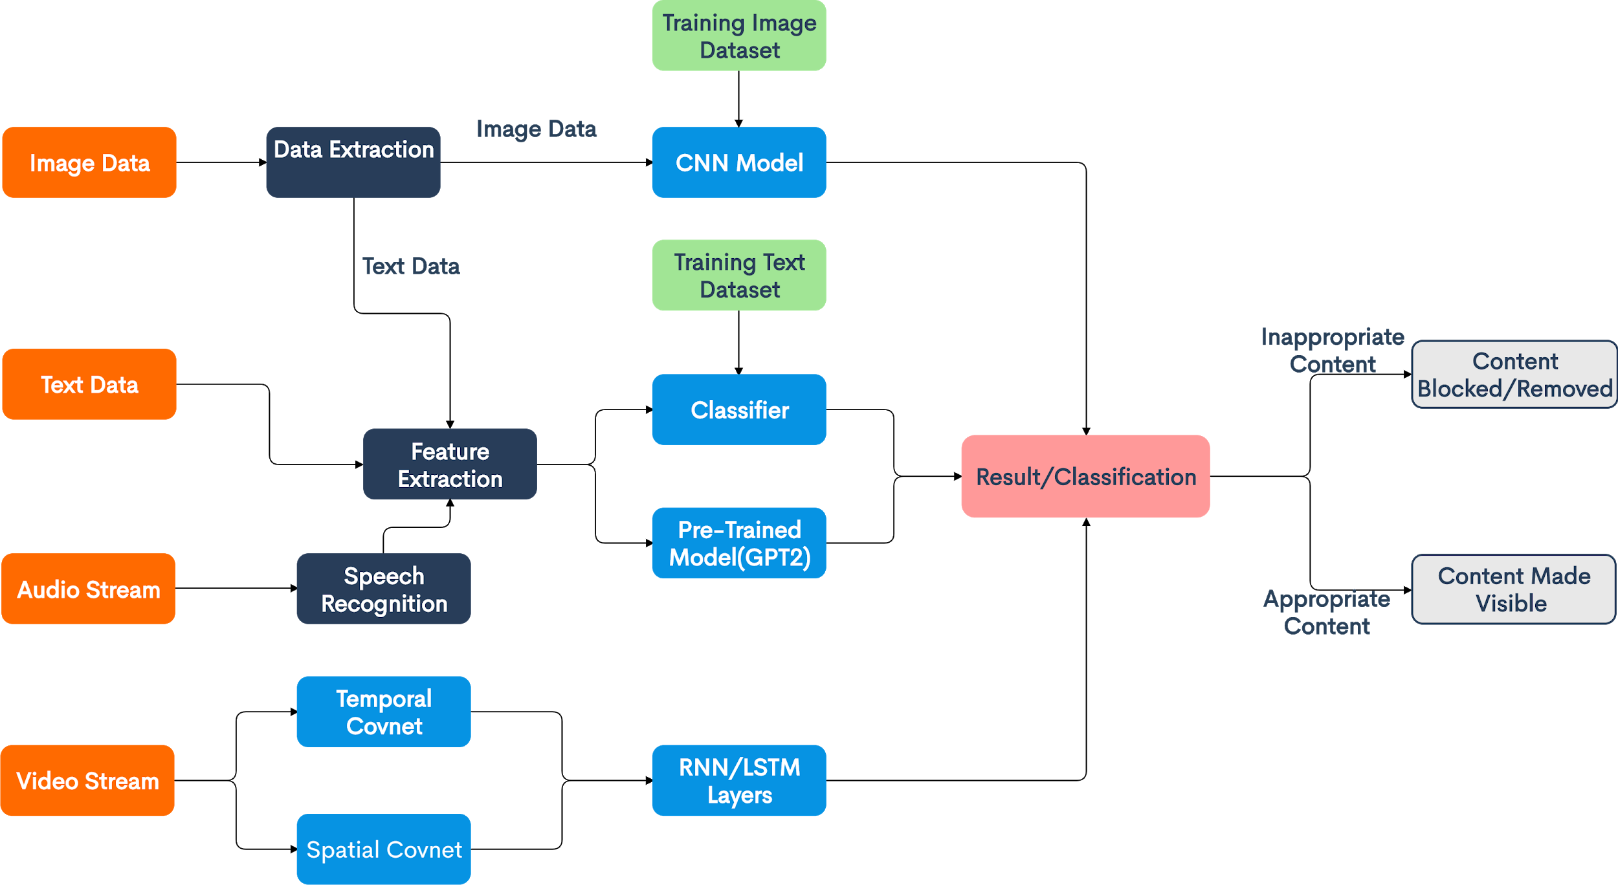
Image data
Text data
Inappropriate Content
Appropriate
Content

Slide 34
PROCESS FLOW
Social Media
User uploads or messages an image/video/audio/text.
Algorithm checks if any offensive or inappropriate text is present in the uploaded material.
If present, it informs the user and waits for changes to be made.
If no offensive text is present and the uploaded material is audio or video, it is uploaded.
If it is an image/video then it checks if the image/ video contains anything inappropriate or vulgar.
If it does, then the algorithm informs the user and waits for another file, otherwise it uploads.
In the case of messages, if it is two people who are following each other who send something mildly inappropriate, the algorithm does not block it as it could be friends fooling around.
If the message content is very inappropriate, then the algorithm blocks the message and shows the user a warning.

Slide 35
PROCESS FLOW
Customer Care
User poses a question/query.
Algorithm checks if the query is spam. If true, then it removes the query.
If not, the algorithm checks for inappropriate content/language in the query.
If true then it asks the user to pose the question in a different way.
If false, then the question is forwarded successfully and the user awaits a response.

Slide 36
PROCESS FLOW
Online Classes
Student enters some text in the chat column.
Algorithm checks if the text is inappropriate.
If true, then it shows the user a warning and asks them to rephrase the question.
If false, then the algorithm checks if a similar question is being spammed in chat section.
If true, then the algorithm blocks the question to avoid redundancy.
If false, the algorithm posts the text and the student awaits a response.

Slide 37
PROCESS FLOW
Second Hand Online Businesses
A buyer contacts a seller regarding a product,
The algorithms checks the messages for inappropriate content.
If true it warns the user and asks them to rephrase the question.
If false, it checks if any of the users are trying to scam the other by offering absurd prices or other means.
If any user is trying to scam, then the algorithm tries to get feedback from the other user about it to better learn to classify such cases.

Slide 38
BUSINESS impact

Slide 39
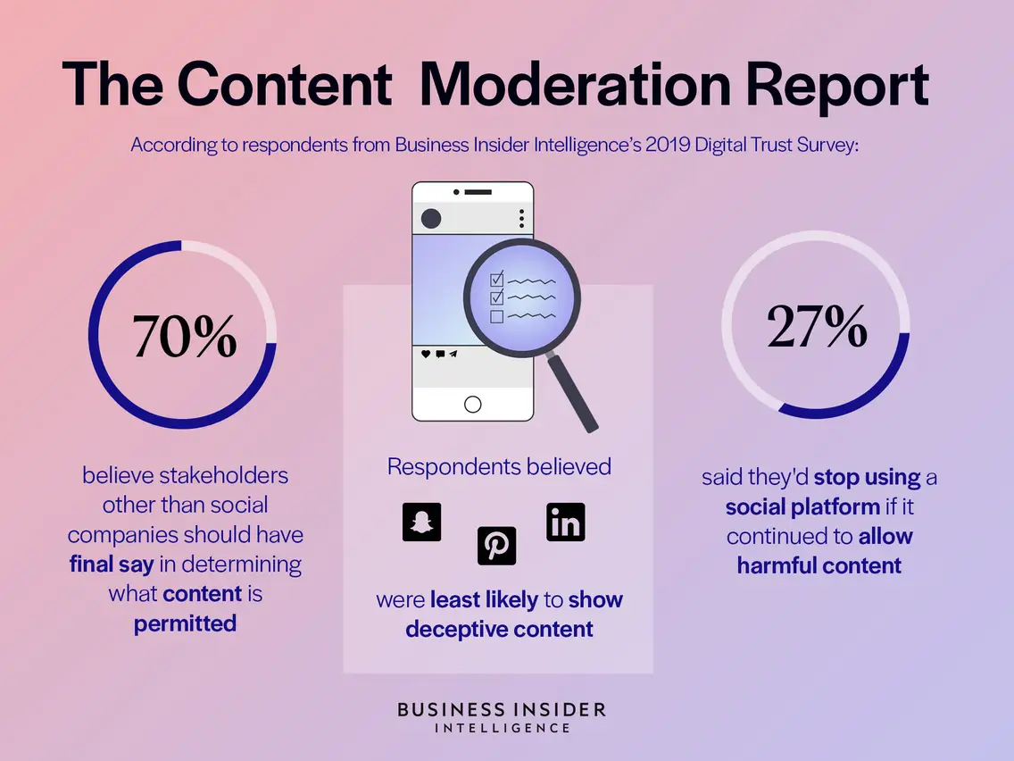
EXPECTED RESULTS
Implementation of content moderation on a large scale could reduce storage costs. An integral element of the information technology (IT) sector, worldwide spending on data storage units is expected to exceed 78 billion U.S. dollars by 2021. Overall, the hosting, storage and computing market is forecast to amount to approximately 163 billion U.S. dollars in the same year, a figure which is the result, in part, of the growing demand from organizations to store greater volumes of data. An example of this could be in online classes. If different students from the same class keep repeating the same question in a short period of time, it becomes redundant. Although the effect seems small here, when applied to bigger industries like online shopping for reviews over longer periods of time, the effect is large.

Slide 40
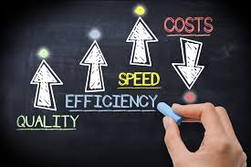
EXPECTED RESULTS
When applied to customer care sector, the model can filter out the irrelevant queries and ignore them, thus reducing the load on the system. The same principal can be applied to the other use cases as well and on an average, the company’s efficiency to deliver their services to the customers will increase. Also once the irrelevant data is removed, the recommendation systems used by the company will also improve automatically, thus leading to a better user experience.
So it is visible that Customer Satisfaction and Company Efficiency are both dependent on each other and if one improves, the other improves as well, thus creating a cycle with a huge scope for profit and delivery of services.

Slide 41
EXPECTED RESULTS
As mentioned earlier, customer satisfaction will go up and people could start using facebook and other left out services again. Prevention of hate speech could be especially useful in online reviews for items. This does not mean we block out the negative reviews, we block the reviews that are offensive and spread more hate than necessary.
Taking the example of some of biggest companies in the world like apple, amazon. They all thrive on customer satisfaction, apple does so with its design and privacy and amazon with its convenience and variety.
Apple’s high nps is the result of an incredible focus on delivering a great product and an exceptional experience to customers. By understanding why and how Apple achieves high customer loyalty, you can create a process that improves customer satisfaction in your own company.
Clearly customer satisfaction can boost business and is infact one of the most important factors to the success of a business .

Slide 42
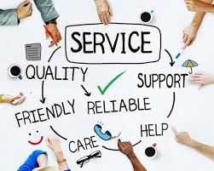
BENEFITS TO THE CUSTOMER
Customers will have an enriched experience as the algorithm will prevent almost if not all cases of racism, discrimination, cyber bullying and any sort of hate speech. The rate of teen depressions should see a fall. Online education will become more effective and people could start to use it more often as an alternative to when offline classes are not possible or not preferred, even after the coronavirus pandemic. Online reviews will be filtered so users can focus on what’s important, instead of the large number of unnecessary comments and reviews made by bots. Buyer and seller harassment could also see a fall as those conversations could also be moderated. This could also lead to decrease in scandalous transactions on the internet.

